Slide 1
Windows Sysinternals技術報告

Slide 2
agneda
Windows Sysinternals
Process Explorer
Autoruns
Process Monitor
ProcDump

Slide 4
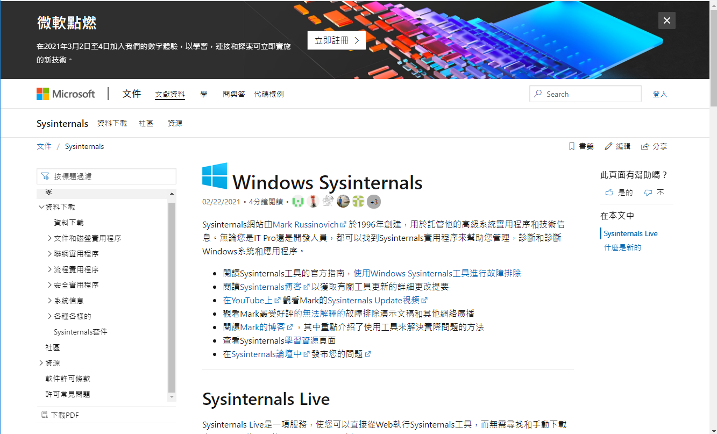

Slide 5
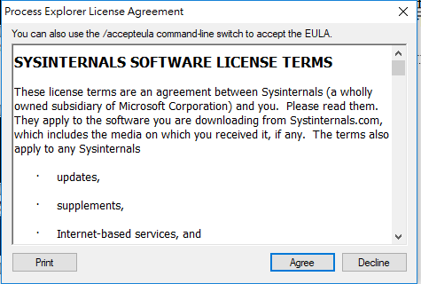
procexp

Slide 6
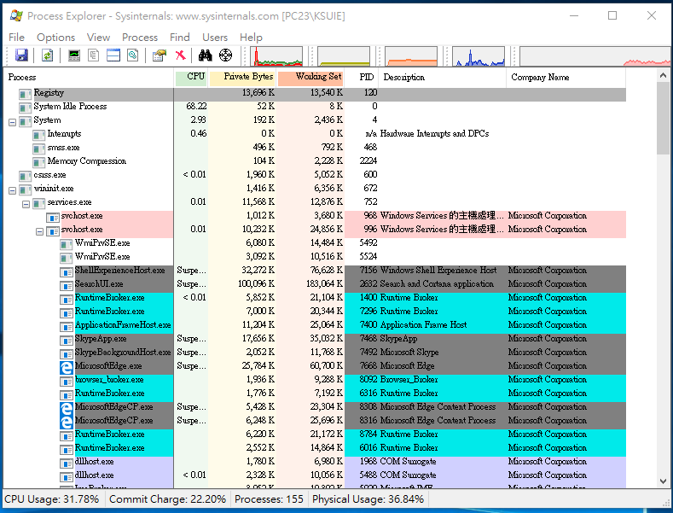
procexp

Slide 7
Coreinfo
Coreinfo is a command-line utility that shows you the mapping between logical processors and the physical processor, NUMA node, and socket on which they reside, as well as the cache’s assigned to each logical processor. It uses the Windows’ GetLogicalProcessorInformation function to obtain this information and prints it to the screen, representing a mapping to a logical processor with an asterisk e.g. ‘*’. Coreinfo is useful for gaining insight into the processor and cache topology of your system.

Slide 8
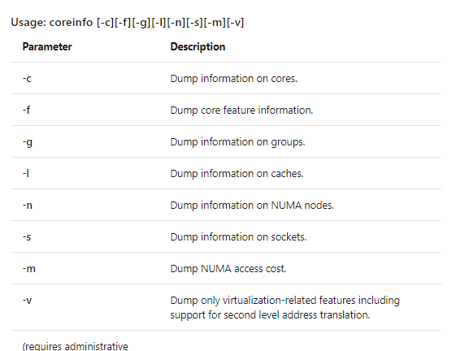

Slide 9
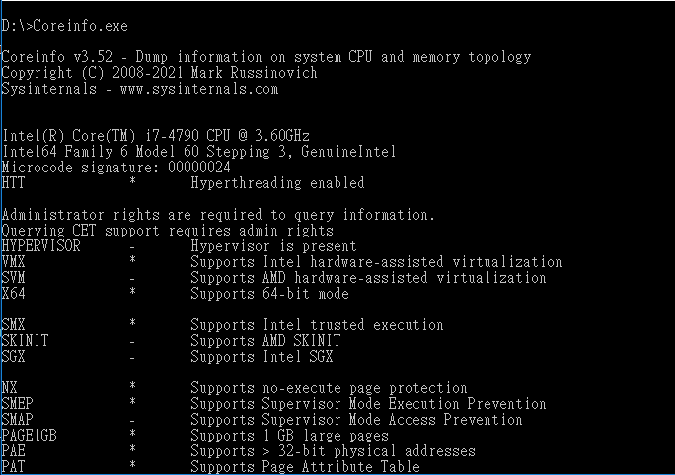

Slide 10
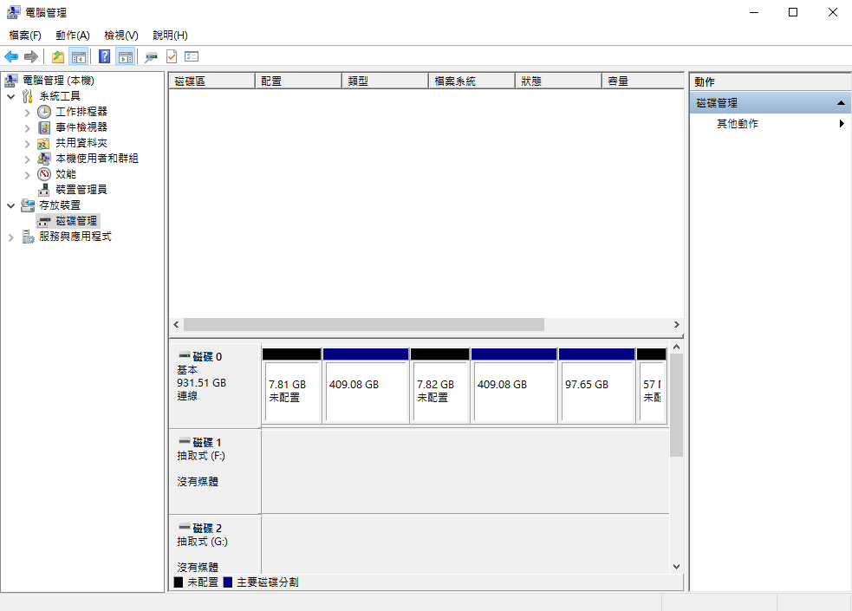
電腦管理-磁碟管理

